Slide 1
Image Classification using CNN
CREATED BY
KAVIPRIYA R
Ⅲ rd year-CSE
Reg . No.:912321104014
SACS M.A.V.M.M Engineering college , Madurai.

Slide 2
Agenda
Problem statement
Proposed system/solution
System development approaches
Algorithm and deployment
Result
Conclusion
References

Slide 3
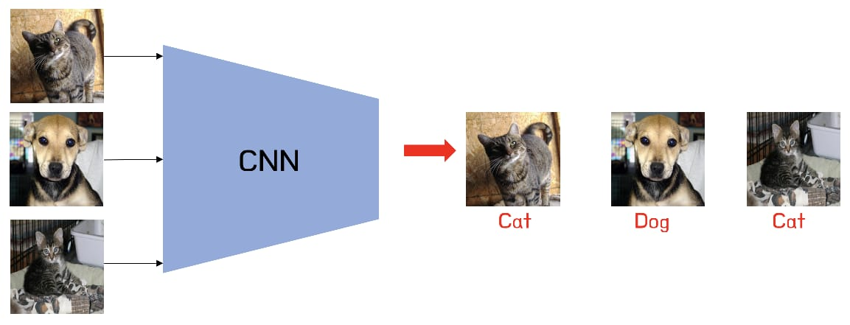
Problem statement
In this project, I given a dataset of images containing various objects/classes, the task is to develop a CNN model capable of accurately classifying these images into their respective categories. The model should be trained on a labeled dataset, validated on a separate validation set, and evaluated on a test set to measure its performance in terms of accuracy, precision, recall, and F1 score.

Slide 4
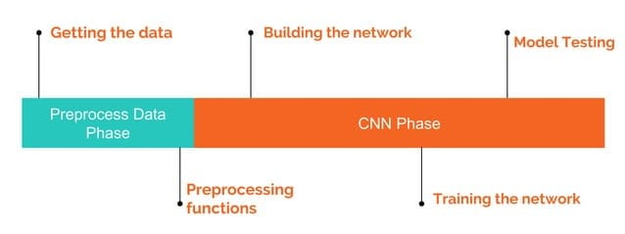
Project overview

Slide 5
Proposed system / solution
Data Preprocessing
Architecture Design
Training Procedure
Hyperparameter Tuning
Evaluation Metrics
Testing and Deployment

Slide 6

Proposed system / solution (Contd…)
1.Data Preprocessing:
This includes tasks such as resizing images to a uniform size, normalizing pixel values, and possibly augmenting the dataset with techniques like rotation, flipping, or cropping to increase its variability.
2. Architecture Design:
Designing the CNN architecture involves selecting the number of layers, types of layers , and their configurations (such as number of filters, and strides).

Slide 7
Proposed system / solution(Contd…)
3.Training Procedure:
Training the CNN involves feeding the preprocessed images into the network, computing the loss , and updating the network's parameters using optimization algorithms.
4.Hyperparameter Tuning:
Fine-tuning hyperparameters such as learning rate, batch size, and dropout rate to improve model performance.
5.Evaluation Metrics:
Assessing the model's performance using metrics like accuracy, precision, recall, and F1-score on a separate validation set.
6.Testing and Deployment:
Evaluating the final model on a held-out test set to gauge its generalization performance, and deploying the model to production for real-world use.

Slide 8
System development approach
The system development approach for image classification using CNNs involves
Problem Definition
Data Collection and Annotation
Data Preprocessing
Model Selection
Model Training
Evaluation Metrics
Error analysis
Deployment and Integration
Testing and Debugging
Monitoring and Maintenance
Continuous Improvement

Slide 9
System development approach(Contd...)
1.Software Development Approach:
Python: The project implemented using python programming languages.
TensorFlow: TensorFlow and its high-level API , Keras, are used for building and training the CNN architecture.
NumPy: NumPy is used for numerical computation.
Matplotlib: Matplotlib is used for data visualization, including plotting loss curves and displaying generated images.
Google colab: These platforms can be used for interactive development, experimentation and documentation.

Slide 10
System development approach(Contd…)
2.Hardware Development Approach:
Computer with a Good Processor: A computer with a decent processor (CPU) to run the code and do basic data tasks like loading and processing images.
Graphics Card (GPU): Having a good graphics card (GPU) can make the training process much faster.
Enough Memory (RAM):Need an enough memory (RAM) to handle the large amounts of data involved in image processing and training.
Fast storage: It's helpful to have fast storage like SSD to quickly load and save data, models, and results.

Slide 11
Algorithm and Deployment
Step 1: Data Acquisition and Preprocessing
Download or access the dataset.
Preprocess the images by resizing them to a uniform size, normalizing pixel values, and augmenting the dataset.
Step 2: Model training
Train the CNN model using the training data.
Evaluate the trained model on the testing set to assess its generalization ability.
Step 3:Model deployment
Choose the deployment environment.
Deploy the saved model to the to the chosen environment.
Implement error handling and logging mechanisms.
Step 4:Model evaluation and maintenance
Continuously monitor the deployed model’s performance and user feedback to identify potential issues.

Slide 12
Architecture and Functionality of CNN(Contd …)
Layers:
Pooling or MaxPooling2D Layer:
In this layer, we are scaling down the size of an image.
Keeping the size (2,2) for the pooling layer.
Flatten Layer:
This layer converts the n-dimensional array to 1 dimensional array.
Dense Layer:
This layer is a fully connected layer i.e.all the neurons in the current layer are connected to the next layer.

Slide 13
Architecture and Functionality of CNN(Contd…)
Model . compile() function:
This function is used to compile the model. Here, we are defining three parameters.
Loss function:
It is used to evaluate how well our algorithm models the dataset.
We can select options like ‘Categorical cross entropy’, ‘Binary cross entropy’, ‘sparse categorical cross entropy’ depending on our dataset.
Optimizer:
With this we can change the attributes of a neural network like weights and learning rate.
Here, we can choose from different optimizers like Adam, SGD etc.
Metrics:
It is used to understand the performance of our model. Eg. Accuracy, Mean Squared Error etc.

Slide 14
Architecture and Functionality of CNN(Contd...)
Model . fit() function:
This function is used to train our model which takes the training and test data to fit our model.
Model . summary() function:
This function is used to see all the parameters and shapes in all layers of our model. Here, we are defining
Epochs
Number of times we are passing the complete dataset forward and backward through the neural network.
Verbose
Options to view our output. Eg . verbose = 0 will print nothing, verbose = 1 will print the progress bar and one line per epoch while verbose = 2 will print one line per epoch.

Slide 15
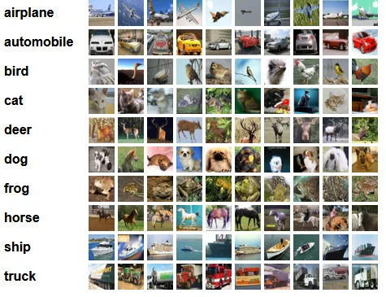
Dataset
CIFAR-10 Dataset as it suggests has 10 different categories of images in it.

Slide 16
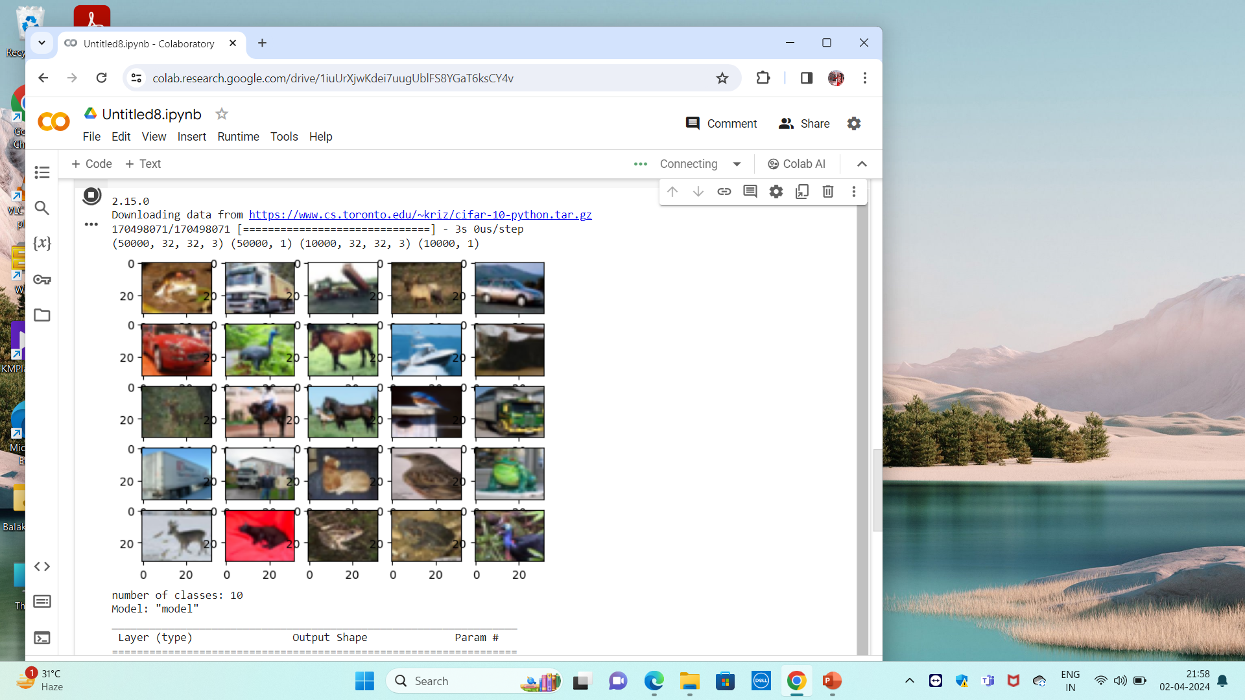
Result

Slide 17
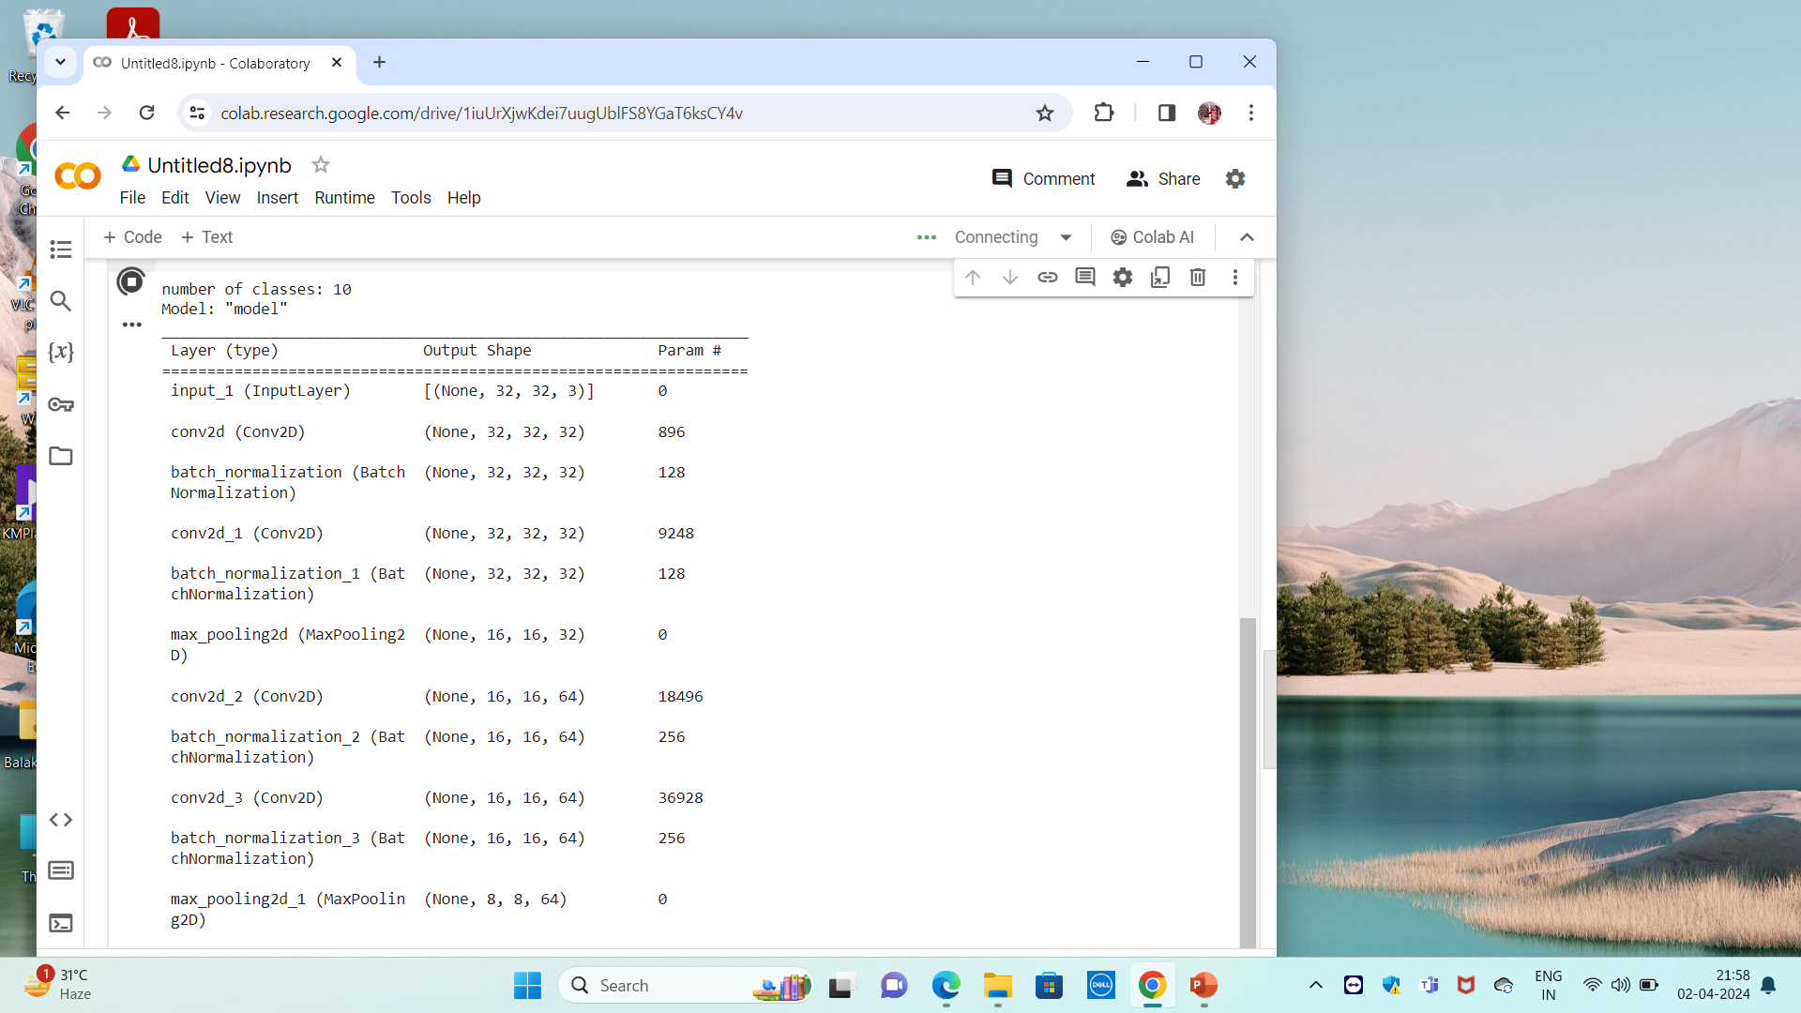
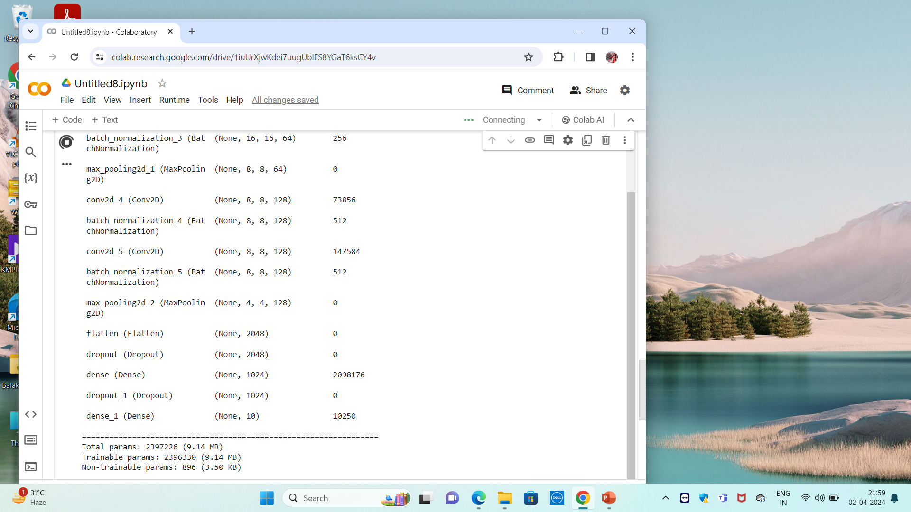
Result(Contd…)

Slide 18
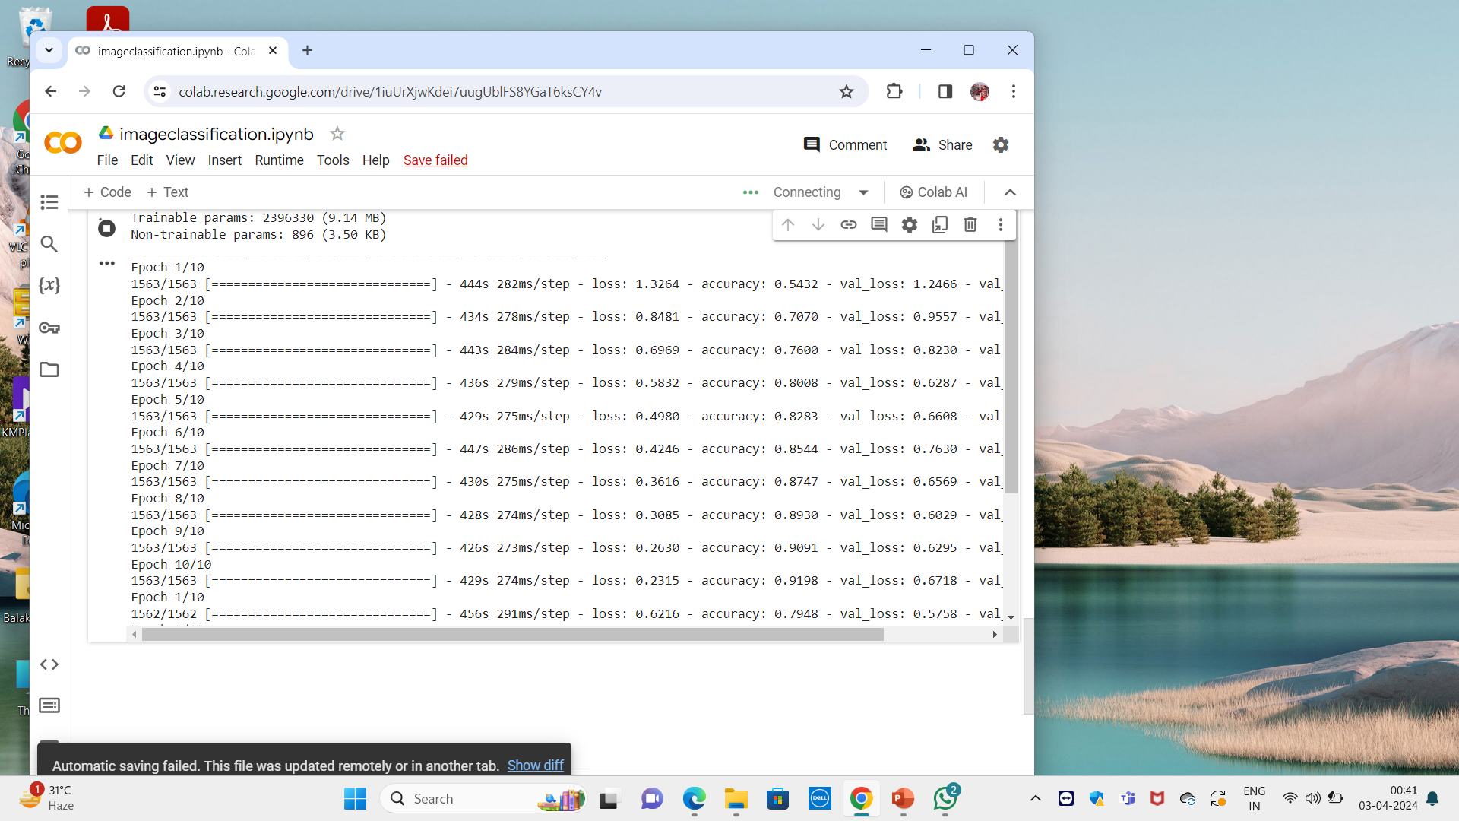
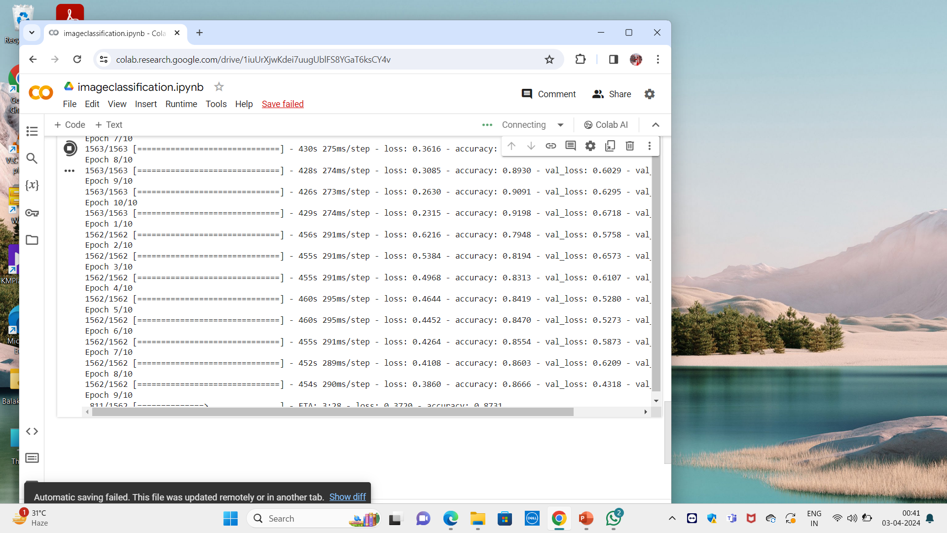
Result(Contd…)

Slide 19
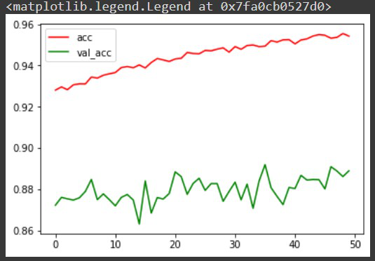
Result (Contd...)

Slide 20
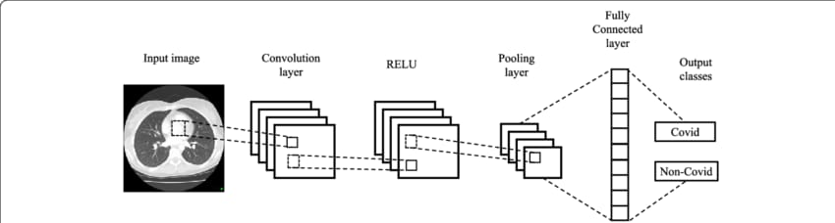
The wow factor in Image Classification
Image classification using CNNs is the ability to achieve human-level or superhuman-level accuracy in certain tasks. CNN-based models have outperformed human experts in tasks like image recognition, object detection, and medical image analysis. CNNs have enabled breakthroughs in fields like medical imaging, where they can assist radiologists in diagnosing diseases from X-rays, MRIs, and CT scans with high accuracy and efficiency.

Slide 21
Conclusion
Image classification using CNNs is a smart way for computers to understand pictures. By using special algorithms called Convolutional Neural Networks, computers can learn to recognize objects in images, like cats, dogs, or cars. These algorithms are trained on lots of labeled pictures, and once trained, they can be used to quickly and accurately identify objects in new pictures. This technology is now used in many everyday applications, from identifying faces in photos to helping self-driving cars see the road.

Slide 22
References
E. Newman, M. Kilmer, L. Horesh, Image classification using local tensor singular value decompositions.
X. Wang, C. Chen, Y. Cheng, et al, Zero-shot image classification based on deep feature extraction.
A.A.M. Al- Saffar, H. Tao, M.A. Talab, Review of deep convolution neural network in image classification.
Farhana Sultana , Abu Sufian , Paramartha DuttaAdvancements in image classification using convolutional neural network.
Neha Sharma , Vibhor Jain , Anju MishraAn analysis of convolutional neural networks for image classification.

Slide 23
THANK YOU.

